Slide 1
Weather Prediction
INSY 695: Enterprise Data Science
Team: Cloud Computations
Week 2 Update

Slide 2





About Our Team
Jake Hogan
Role: Data Analyst
Duncan Wang
Role: Product Manager /
Data Analyst
Steven Liang
Role: Product Manager /
SME
Hanna Swail
Role: Data Scientist /
UX/UI Specialist
Richard Gao
Role: Business Analyst
/ Architect

Slide 3
Why Weather?
Accurate weather forecasts → crucial social / economic priority: - Benefits / Impact: Transportation, Tourism, Agriculture - Investment in public weather forecasts: benefit +$31 billion (The US Weather Service, Lazo et al. 2009)
Classical Approaches to Weather Forecasting - Meteorologists use complex climatological models constructed from data such as: - Weather stations, to balloons, to radar and satellites - Limitation: access to good forecasts can be geographically constrained.
While these models have been successful, there is still a significant opportunity for machine and deep learning models to improve the accuracy and geographic availability of traditional weather forecasting.

Slide 4
WHAT:
HOW:
WHY:
Objectives
Historical Time-Series Data: - Predict average daily temperatures for the next week - Explain what factors are driving local weather patterns
Compare and contrast algorithms applied to a time-series context: Parametric, ML, and DL
Opportunities to complement existing meteorological model-based forecasts
Cost effectiveness (no additional expensive data collection required)
Can be applied to rural areas where high-quality existing forecasts are unavailable.

Slide 5
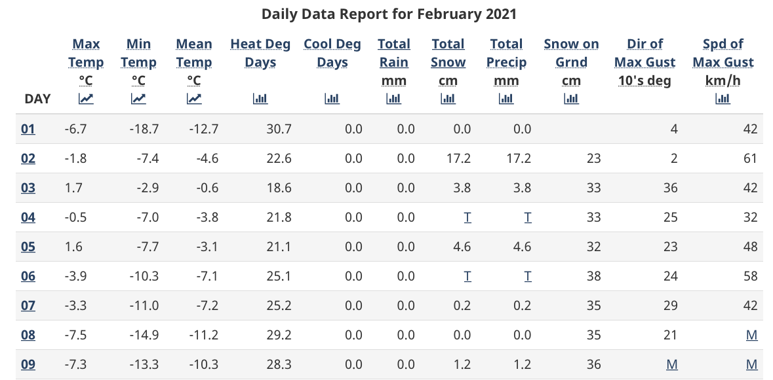
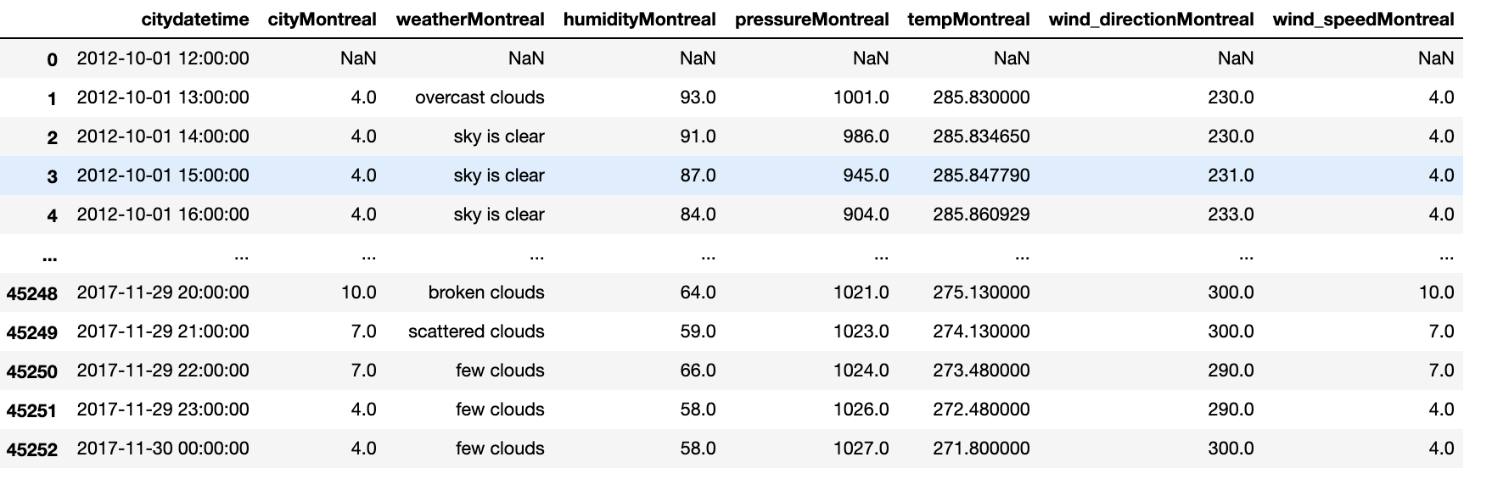
Data & Overview
Historical data available as public record for many places (including Montreal)
New data can be accessed using the openweathermap API
Metrics include:
Temperatures
Precipitation
Wind Direction
Wind Speed
Air pressure
Humidity

Slide 6
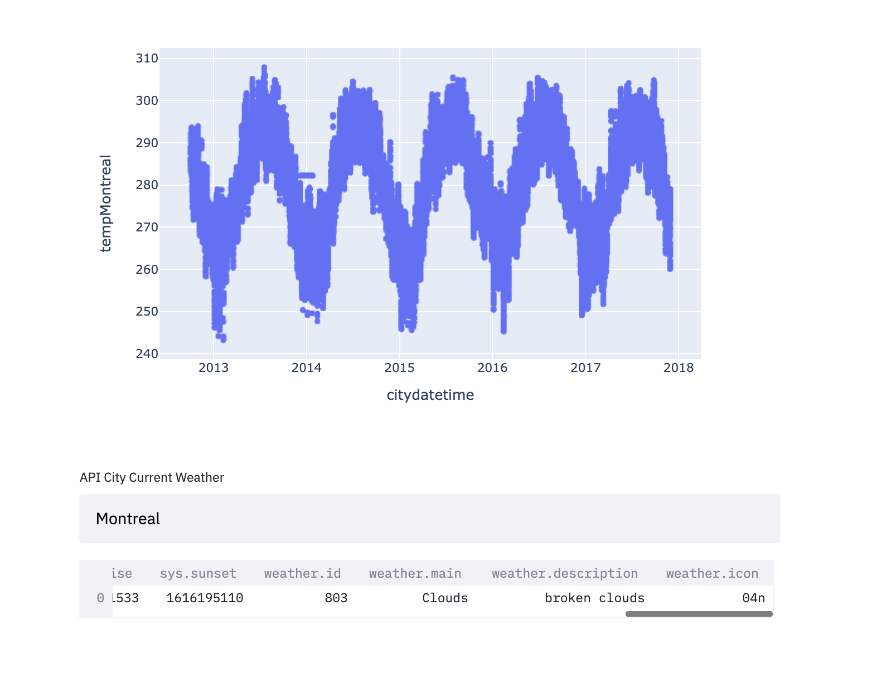
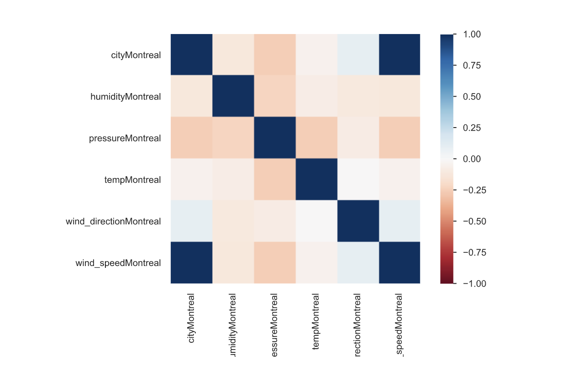
Data Cont.

Slide 7
Methods / Class Concepts
Model Building -- Opportunity to Compare Model Classes:
Parametric: ARIMA, GAM
SOTA ML: Random Forest, XGBoost
Deep Learning: RNN, LSTM, GRU
Time-series Anomaly Detection: Isolation forest
Causal Inference/Business Explainability:
Which variables are causing temperature changes and in what manner?
Transformers:
Opportunity to increase parallelization & reduce training time of NNs through encoder-decoder architecture
Monitoring Model Stability & Drift (target & model drift)
Docker Containerization & Deployment
Streamlit/Dash UI
Batch & Streaming options with new data pulled from APIs

Slide 8
Steps for Next Week
TASK 1
Build base prediction models for Montreal data & compare:
ARIMA
Tree-based ML
RNN-based DL
TASK 2
Extend base models by finding & incorporating reliable external data source (i.e. special meteorological events, El Nino, etc.)

Slide 9
END

